Slide 1
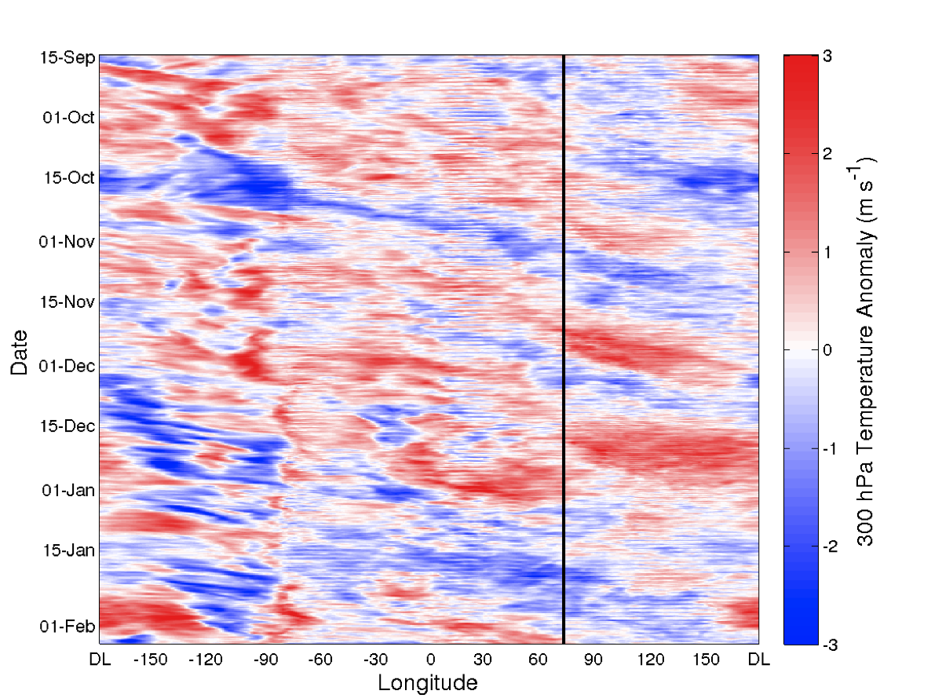
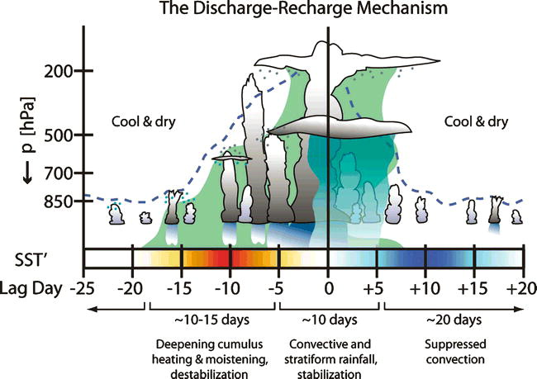
Radar-Based and Large-Scale Views of Convection and Tropospheric Humidity during DYNAMO/AMIE
Scott W. Powell and Robert A. Houze, Jr.
University of Washington, Seattle, WA
1. Introduction
4. Radar and Rawinsonde Observations
Two hypotheses concerning onset of convection in association with the MJO are examined.
Knutson and Weickmann (1987) show evidence that an equatorial Kelvin wave response to one convective event circumnavigates in the upper-troposphere as a velocity potential anomaly, exciting the next event.
Bladé and Hartmann (1993) propose a “discharge-recharge” mechanism: Convection and humidity feedback onto each other, thus allowing humidity to slowly build vertically as convection becomes gradually taller in the 10 to 20 days prior to a convective event.
Efforts to model the MJO require adequate representation of cloud microphysics and dynamics. Convection is linked to the large-scale circulation via latent heating by cumulus clouds and large stratiform regions, thus any existing relationship between the cloud population and environmental humidity must be determined. Additionally, microphysical properties of the cloud population must be examined in order to anchor numerical simulations to such observations.
Humidity on MCS Days and Non-MCS Days
- Similar humidity on both MCS days and non-MCS days (>70% below 500 hPa).
- Although echo top PDF for Non-MCS Days and suppressed WH MJO phases are very similar, differences in humidity during these days are statistically significant (p = 0.05) at the levels shaded in gray.
- Dynamical support , which probably varies dependent on equatorial wave modes, is more important than environment humidity for developing deep convection.
Benedict and Randall (2007)
AMIE Rawinsonde Time Series
Echo-top Heights and Humidification
5. Equatorial Kelvin Wave
Time series of u’, v’, T’, and q*’ are shown below. Anomalies are computed relative to the time mean at each pressure level (binned to 5 hPa intervals) for the period shown. q*’ is the fractional difference from the time mean of specific humidity.
Time series of PDF for 20 dBZ echo-top heights smoothed into three-day intervals. Red line follows the modal distribution.
Time series of q*’ smoothed to three-day intervals. Black line is the same as red line in (a). Contours are Eulerian derivative of q*’.
ERA-Interim reanalysis is used to extend rawinsonde dataset to evaluate three-dimensional wind field. Below is the 150 hPa u’.
Black dashed lines correspond to phase speed of Kelvin wave, which is identifiable objectively and subjectively in 2-dimensional analysis of wind field.
CE1
CE2
10.7 m s⁻¹
23.4 m s⁻¹
CE3
At Addu, an easterly anomaly precedes a westerly anomaly during each convective event. No such feature (of opposite sign) is observed to propagate from the west at lower levels. We propose that the large-scale changes in divergence and subsidence in the upper-troposphere (down to 300 hPa) caused by the Kelvin wave modulates the convection on MJO-related timescales.
The Kelvin wave appears to circumnavigate and excite convective events in October and November. Whether the signal continues to circumnavigate is unclear in the present analysis. Regardless of the source of the Kelvin mode, a convective event does not begin at Addu until the divergent upper-level anomaly approaches from the west.
26-30 day variability is seen in u’ and T’ at 150 hPa. Deep westerly anomalies observed in late November and mid-to-late December.
Warm and moist anomalies between 500 and 200 hPa correspond with convective events.
Dry, suppressed conditions in January.
- Rapid increase in convective echo-top heights occurs at beginning of October and November convective events. Smaller increase observed more gradually in December. The period of moistening prior to a convective event lasts no more than 10 days. While episodes of moistening may occur even earlier (November and December), drying occurs before moistening begins again. This is clearly inconsistent with the “discharge-recharge” mechanism.
- The direct relationship between clouds and humidity is inconclusive. For three convective events, the increase in convective echo-top heights occurred after (October), before (November), and during (December) the greatest increase in moisture through a deep layer.
2. Objectives
6. Cloud Microphysics derived from KAZR and S-PolKa
3. Instrumentation
7. Conclusions/Future Work
Creation of this poster was supported by DOE grant DE-SC0008452.

